Slide 1
INDUSTRIAL CONTROL TECHNOLOGY
By
Dr. V S Krushnasamy
9994431562

Slide 2
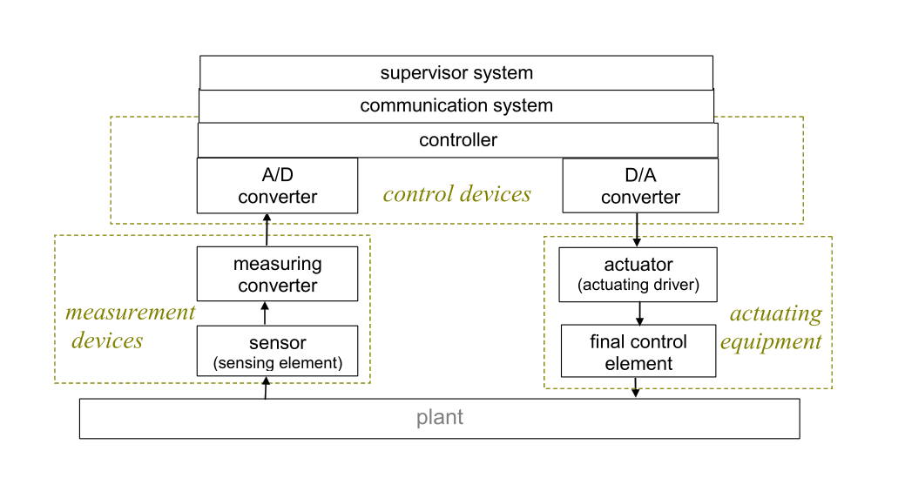
ICS Block Diagram

Slide 3
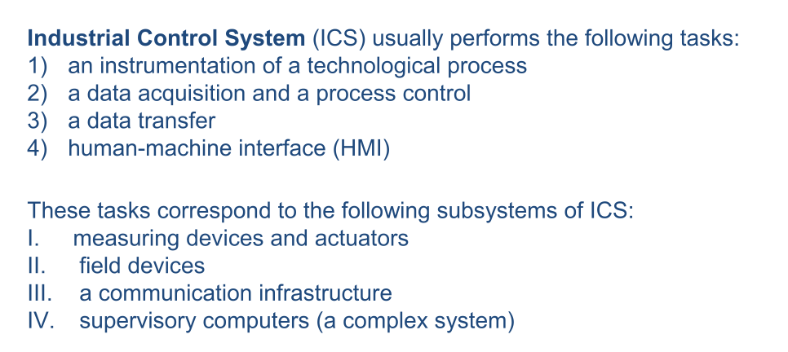

Slide 5
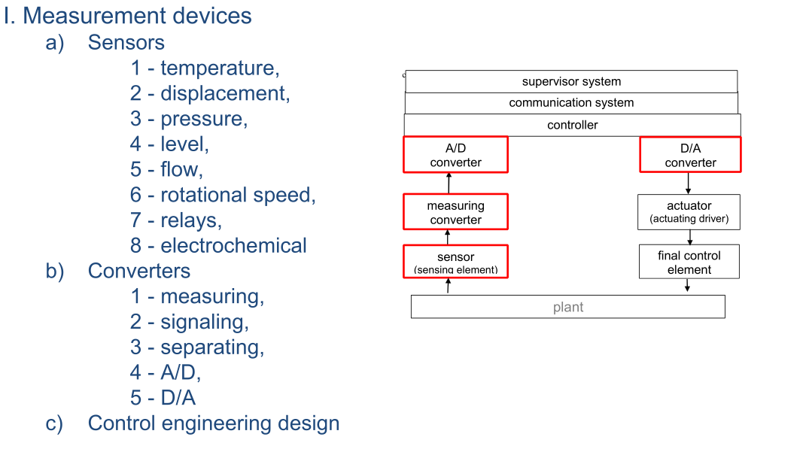

Slide 6
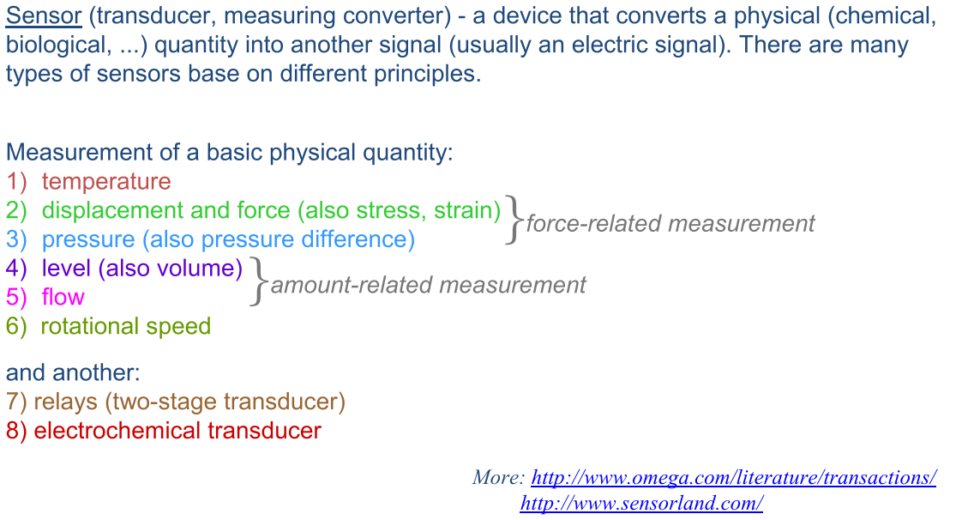

Slide 7
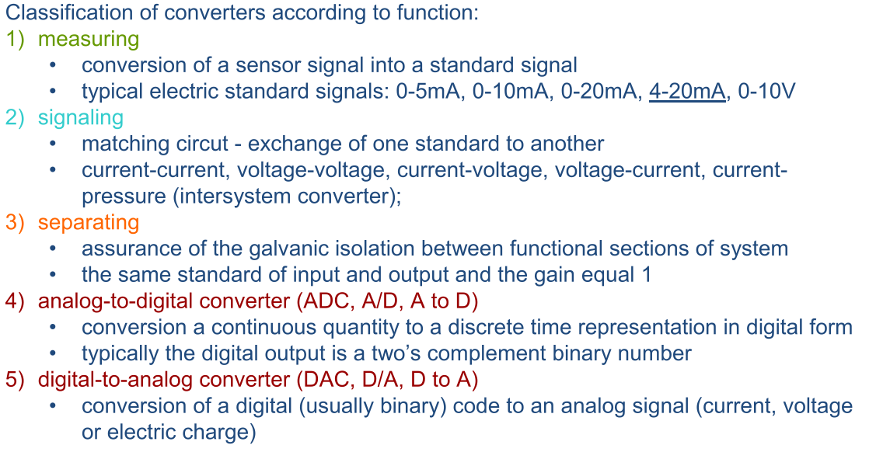

Slide 8
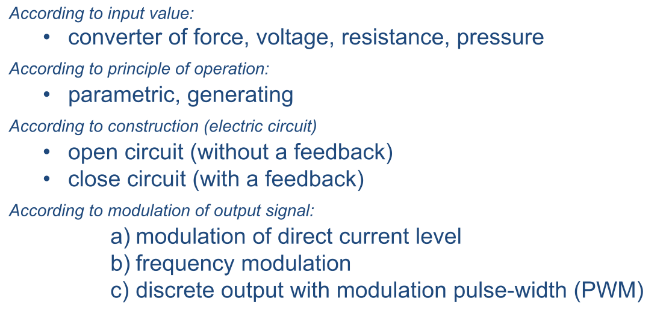

Slide 9
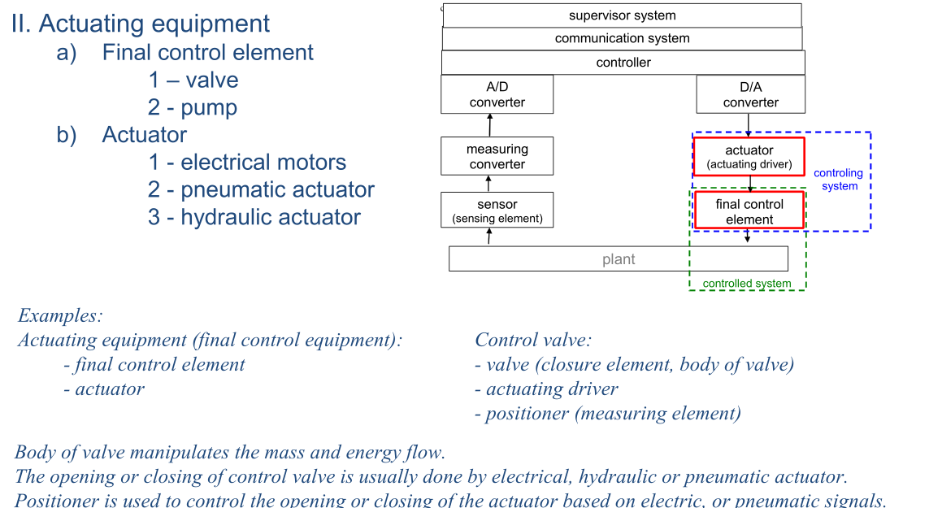

Slide 10
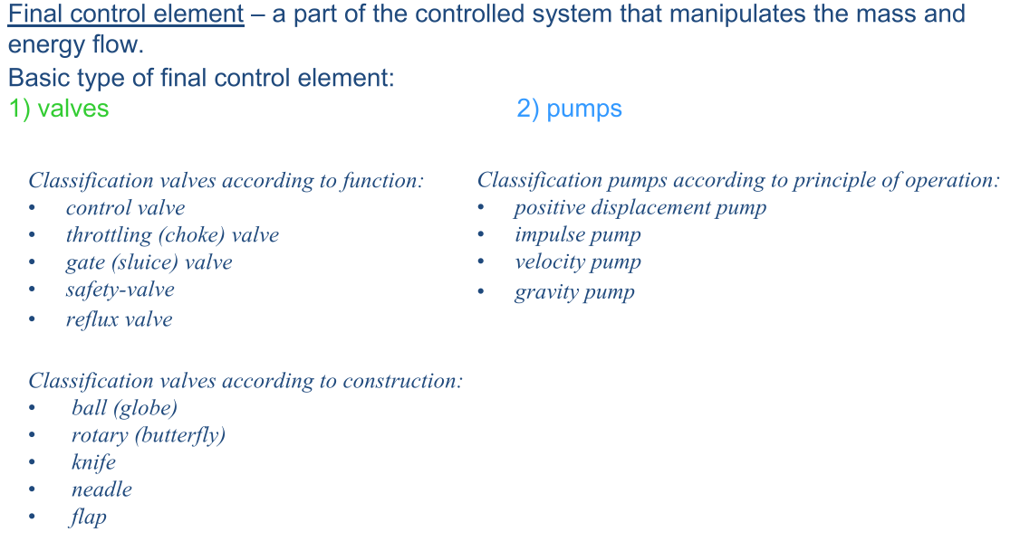

Slide 11
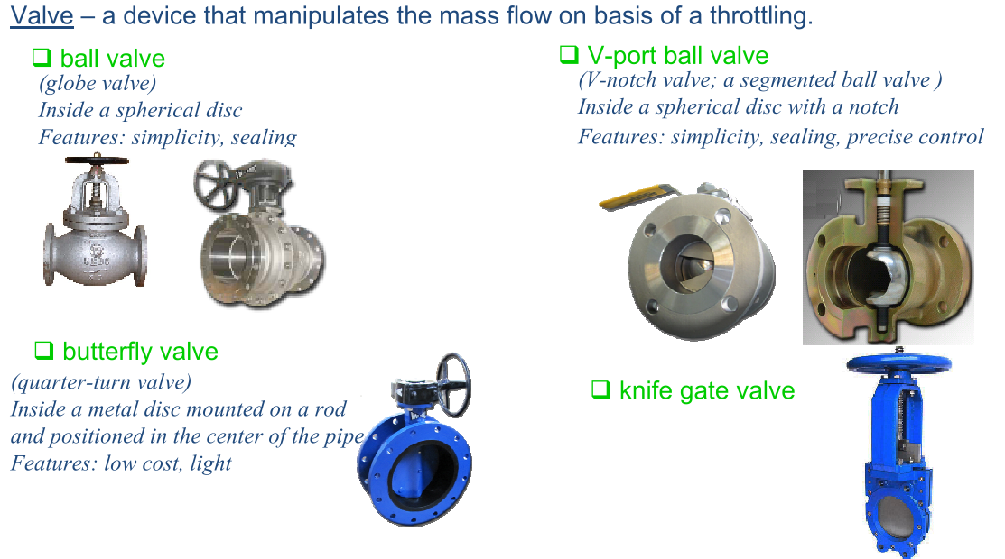

Slide 12
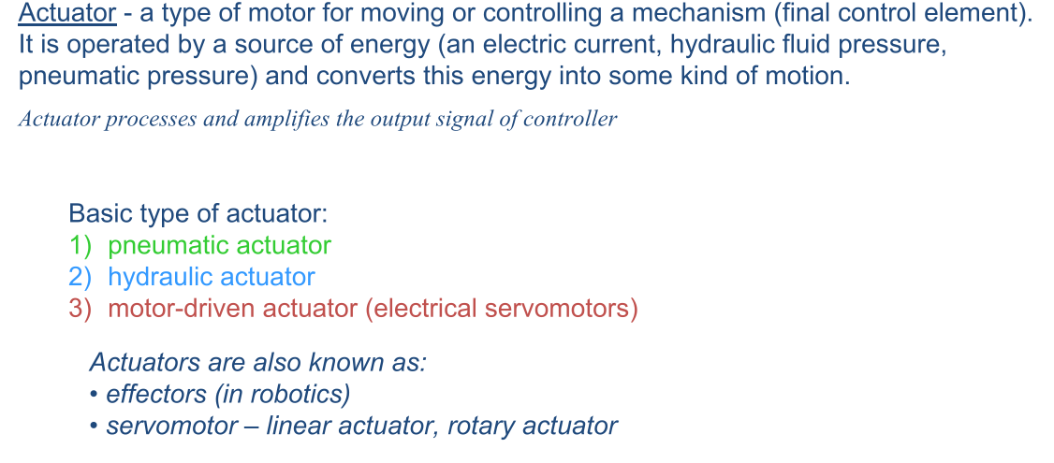

Slide 14
Industrial Control Technology
Embedded control systems
Realtime control systems
Distributed control systems.
The principles and functions, the architectures and components, and the implementation techniques for each of the three control systems.

Slide 15
An embedded control system is a specially organized computer system designed for some dedicated control function or task.
Its distinct feature is that its input/output system is not connected to an external computer; the microprocessor that controls the system is actually embedded in the input/ output interface itself.
Though the hardware differences between an embedded controller and a standard computer are obvious, the differences in software are also substantial.
While most computers are based on operating systems requiring large memory size, such as the Windows or Linux operating systems, the typical embedded control system uses a smaller operating system, which has been developed to provide a simple and powerful graphical user interface (GUI).

Slide 16
An embedded control system refers to the computer hardware and software which are physically embedded within a large industrial process or production system.
Its function is to maintain some property or relationship to other components of the system, in order to achieve the overall system objective.
Embedded control systems are designed to perform a specific control task, rather than multiple tasks as a general-purpose computer does.
Embedded control systems are not always separate devices or components, but are often integral to the controlled devices.
The software designed for embedded control systems comprises embedded firmware, embedded operating systems, and special application programs.
Compared with general computer software packages, embedded system software is rather smaller in size, and thus able to run with limited hardware resources, and without the keyboard and screen needed for most applications.
The embedded control software is stored in memory chips rather than on a hard disk. Due to these differences, embedded control systems have achieved wide applicability in industry world-wide.

Slide 17
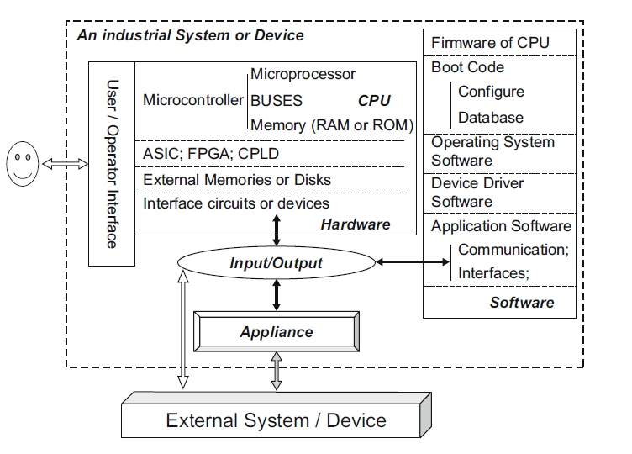
The hardware architecture of embedded control systems

Slide 18
Embedded control systems are generally developed on the customer’s hardware, and often require high quality and reliability, and compatibility with real-time controls.
Many use distributed architectures, on which a large number of processes are able to run concurrently.
Such systems will commonly have several different types of general-purpose microprocessors, microcontrollers and application-specific integrated circuits (ASIC), all interconnected with communication links to work with embedded software. It is crucial that each process can be executed with a variety of hardware modules and software programs.
The core of an embedded control system is a microprocessor, designed to operate a set of machine instructions, including firmware and boot-code, which are stored in the hardware memory.
Another important hardware component is the microcontroller, typically a CPU core for the processing functions, together with a bus interface for communication with memory components and external or peripheral devices

Slide 19
A microprocessor (MPU) acts as the central processing unit (CPU) for handling complex computations, executing control algorithms, and processing large amounts of data.
A microcontroller (MCU) integrates a CPU with memory and peripherals, making it suitable for real-time control tasks.
Embedded control systems often require real-time responses to sensor inputs.
MCUs with built-in timers and interrupt handling mechanisms ensure precise execution of tasks.
Microcontrollers come with built-in analog-to-digital converters (ADC), digital-to-analog converters (DAC), PWM generators, timers, UART(Universal Asynchronous Receiver-Transmitter), SPI(Serial Peripheral Interface), I2C (Inter-Integrated Circuit), and GPIO pins (General-Purpose Input/Output), allowing direct interface with sensors and actuators.
Many embedded systems are battery-powered (e.g., IoT devices, wearables).
Microcontrollers are optimized for low power consumption, unlike general-purpose microprocessors that require external memory and power-hungry peripherals.
MCUs integrate RAM, ROM, and I/O ports, reducing system complexity and cost.
Microprocessors require external components, increasing cost and design complexity but offering greater flexibility.
Embedded systems require wired (CAN(Controller Area Network), UART, SPI, I2C, RS-485) and wireless (Wi-Fi, Bluetooth, Zigbee, LoRa) communication.

Slide 20
An ASIC chip is designed for a specific application, rather than being a general-purpose CPU, since it does not incur the overhead of fetching and interpreting instructions stored in memory.
ASIC chips can be based on standard cells, gate arrays, field-programmable gate arrays (FPGAs), or complex programmable logic devices (CPLDs).
Embedded control systems employing reconfigurable hardware such as FPGA and CPLD are referred to as reconfigurable embedded systems. Reconfigurable systems can provide higher performance and flexibility to adapt to changing system needs at lower cost.
An embedded control system should have storage elements; typically, software executed by microprocessors or microcontrollers.
For data storage, the microprocessor or microcontroller can include various types of memories, such as random-access memory (RAM), read-only memory (ROM) or flash memory. Flash memory can be erased and reprogrammed in blocks instead of being programmed one byte at a time.

Slide 21
For transmitting and receiving data between devices and components, the microprocessor, microcontroller, ASIC and other devices may utilize various types of serial interfaces, parallel interfaces or buffers.
Buffers are used by microprocessor to store operating data temporarily.
The Appliance in the diagram represents the actual system or device that the embedded control system is managing or controlling. It acts as the core functional unit that interacts with both the embedded system hardware/software and external systems/devices.

Slide 22
Few Facts About Components
1. Microcontroller / Microprocessor (CPU)
The brain of the system, executing instructions and processing data.
Manages all system operations by running embedded software.
Controls input/output operations and communication with peripherals.
2. Memory (RAM or ROM)
RAM (Random Access Memory): Temporary storage for actively running processes and data.
ROM (Read-Only Memory): Stores firmware and essential system programs that do not change during operation.

Slide 23
3. BUSES
Data communication pathways that allow different components to exchange information.
Includes address bus, data bus, and control bus for proper data flow within the system.
4. ASIC; FPGA; CPLD
ASIC (Application-Specific Integrated Circuit): Customized chip designed for a particular task, improving efficiency.
FPGA (Field-Programmable Gate Array): Reconfigurable hardware for high-performance processing tasks.
CPLD (Complex Programmable Logic Device): Used for implementing logic control functions in hardware.
5. External Memories or Disks
Additional storage for application data, logs, or large software modules.
Can be EEPROM, Flash Memory, SD cards, or Hard Disks in advanced systems.
6. Interface Circuits or Devices
Bridges communication between the CPU and other external components.
Includes analog-to-digital converters (ADC), digital-to-analog converters (DAC), sensors, actuators, and signal conditioning circuits.

Slide 24
7. Input/Output (I/O)
Manages interaction with external devices like displays, keyboards, sensors, or actuators.
Acts as a gateway for data transfer between hardware components and external peripherals.
8. Appliance
The actual system or device being controlled by the embedded system.
Examples: Robots, Industrial Machines, Automotive Systems, Medical Devices.
9. External System / Device
Other systems that exchange data with the embedded system via communication interfaces.
Examples: Cloud servers, IoT gateways, external sensors, networked control systems.
10. User / Operator Interface
Provides a way for users to interact with the system.
Examples: Touchscreens, Buttons, Keypads, LED Indicators, HMIs (Human-Machine Interfaces).
These hardware components work together to execute software instructions, process data, and ensure real-time functionality in embedded control systems.

Slide 25
The software architecture of embedded control systems
Many embedded control systems are required to fit real-time or multiple-process environments.
Realtime or multiple-process operating systems are defined in the software, allowing the system to perform in a general-purpose control environment.
Real-time operating systems, in comparison with non-real time operating systems, offer much shorter response times.
An embedded control system normally executes software in which the user interface is used as a system interface.
A program package for application software isa necessary component of embedded control system software architecture.
This application software runs under the control of a real-time operating system (RTOS) and is partitioned into one or more threads or tasks.
A thread or task is an independent object of executable software that shares the control of the microprocessor with other defined threads or tasks within the embedded control system.
Embedded system software exists in many forms; such as software in a network router, or system software in a controlled device.

Slide 26
The software architecture of embedded control systems
The firmware and boot-code are also important parts of embedded system software, since they contain its configuration parameters. These allow an embedded control system to access and configure the system by setting its values.
Different processes can run in different modules, which can work together if the configuration parameters of this system are properly set.
Configuration database is included in the firmware and boot-code, so to improve system performance it is just necessary to upgrade the firmware and boot-code, or change this configuration database.

Slide 27
1. Firmware of CPU
The firmware is low-level software that provides the foundational instructions for hardware initialization and operation.
It includes:
Boot Code: Initializes the system, sets up the hardware, and loads the operating system.
Configure Database: Stores system settings and parameters that define how the device should behave.
2. Operating System Software
The Operating System (OS) manages system resources, schedules tasks, and provides an interface between hardware and applications.
In real-time embedded systems, this is often a Real-Time Operating System (RTOS) to ensure deterministic behavior.

Slide 28
3. Device Driver Software
Device drivers act as an interface between the operating system and hardware components (e.g., sensors, actuators, communication modules).
They allow higher-level software to interact with hardware without needing to understand the specific hardware details.
4. Application Software
The application software is responsible for executing specific tasks related to the embedded system’s function.
It typically consists of:
Communication Software: Handles data exchange between different system components and external devices using protocols like UART, SPI, I2C, or Ethernet.
Interfaces: Manages user interactions, graphical interfaces (if applicable), and command processing.
These software components work together to ensure the smooth operation of an embedded control system by managing hardware, executing real-time tasks, and enabling communication and configuration.

Slide 29
Implementation methods
Planning automatic control strategies;
Verifying machine systems and components;
Engineering of embedded software including architecture design, code programming and testing;
Engineering of embedded hardware including computer components and electronics components;
Carrying out dependability tests and evaluations.

Slide 30
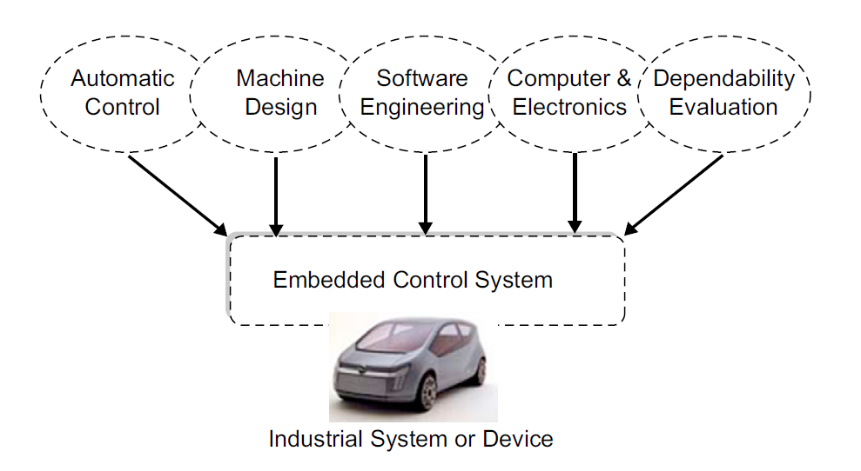
Implementation methods

Slide 31
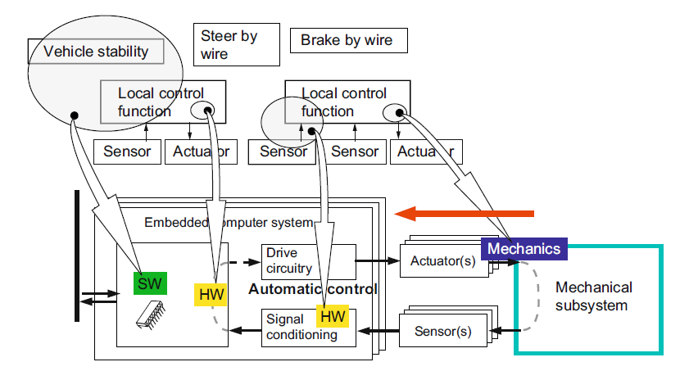
Implementation methods
Control function mapping for hardware implementation

Slide 32
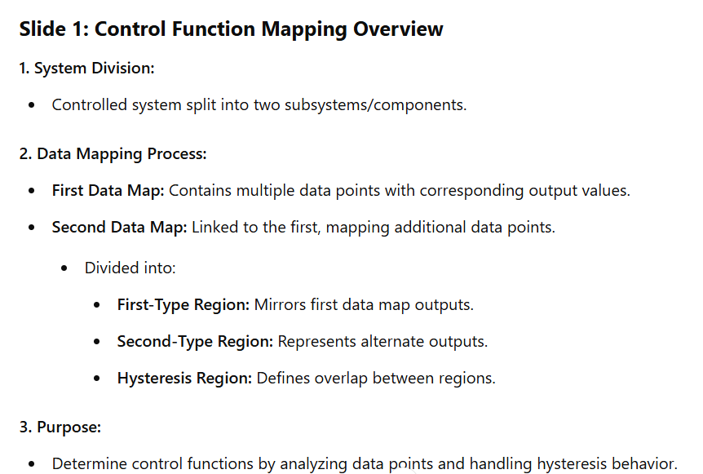

Slide 33
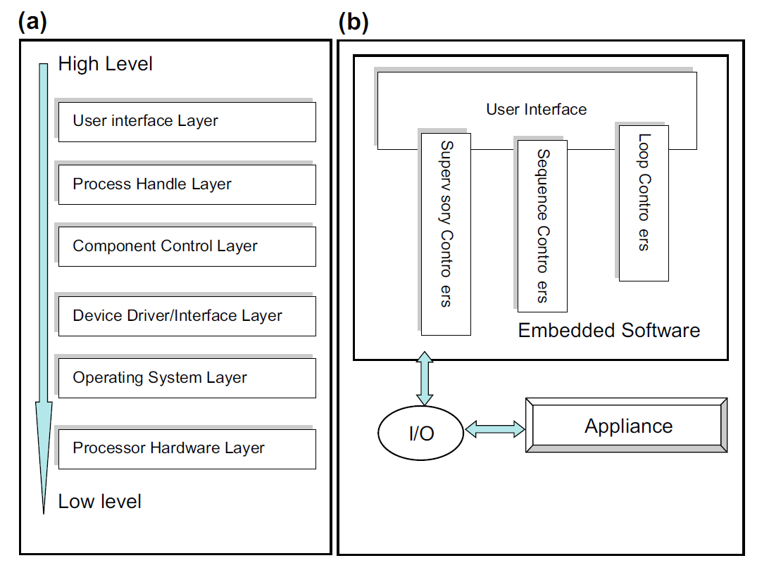
Two types of software architectures for embedded control systems: the left panel (a) is the layers model; the right (b) is the classes model.

Slide 34
1. User Interface Layer
Function: This layer provides the interface through which users (such as drivers or vehicle operators) interact with the embedded system.
In automotive systems, this could include elements like the dashboard display, touchscreens, or any user control inputs (e.g., buttons, knobs).
It translates user commands into actions that the embedded system can understand and respond to.

Slide 35
2. Process Handle Layer
Function: This layer manages the execution of processes or tasks within the embedded system.
It includes task scheduling, process synchronization, and communication between different software components.
In automotive systems, it ensures that critical processes like
sensor data reading,
actuator control,
user command processing
are handled efficiently and in a timely manner.

Slide 36
3. Component Control Layer
Function: This layer handles the direct control of various hardware components in the vehicle, such as sensors, actuators, and other peripherals.
It converts high-level commands from the process handle layer into specific instructions for components.
For example, it could manage the throttle control, brake actuators, or control signals to engine management systems.

Slide 37
4. Device Driver/Interface Layer
Function: This layer acts as an intermediary between the operating system and the hardware.
It includes drivers that facilitate communication with hardware components such as sensors, actuators, communication interfaces (CAN bus), and other peripherals.
In automotive embedded systems, it ensures that hardware components can be accessed and controlled by higher-level software.

Slide 38
5. Operating System Layer
Function: This layer provides the foundational software environment in which application software runs.
It includes real-time operating systems (RTOS) that are crucial in automotive systems to ensure tasks are executed within defined time constraints.
The operating system manages resources like CPU, memory, and I/O devices, and provides services like task scheduling, interrupt handling, and time management.

Slide 39
6. Processor Hardware Layer
Function: This is the lowest layer consisting of the actual hardware components, including the microprocessor or microcontroller, memory, and other critical hardware peripherals.
In automotive embedded systems, this layer is responsible for executing machine code instructions and interfacing directly with all physical components of the vehicle's embedded system.

Slide 40
1. Adaptive Cruise Control (ACC)
2. Anti-lock Braking System (ABS)
3. Electronic Stability Control (ESC)
4. Automatic Emergency Braking (AEB)
5. Lane Keeping Assist System (LKAS)
6. Automatic Parking Assist
7. Adaptive Headlights
8. Collision Avoidance System
9. Automatic Transmission Control
10. Adaptive Suspension System
11. Blind Spot Monitoring (BSM)
12. Hill Descent Control (HDC)
13. Automatic Climate Control
14. Start-Stop System

